Slide 1
How autodiff changed the world
02457 Machine Learning Operations
Nicki Skafte Detlefsen,
Postdoc
DTU Compute

Slide 2
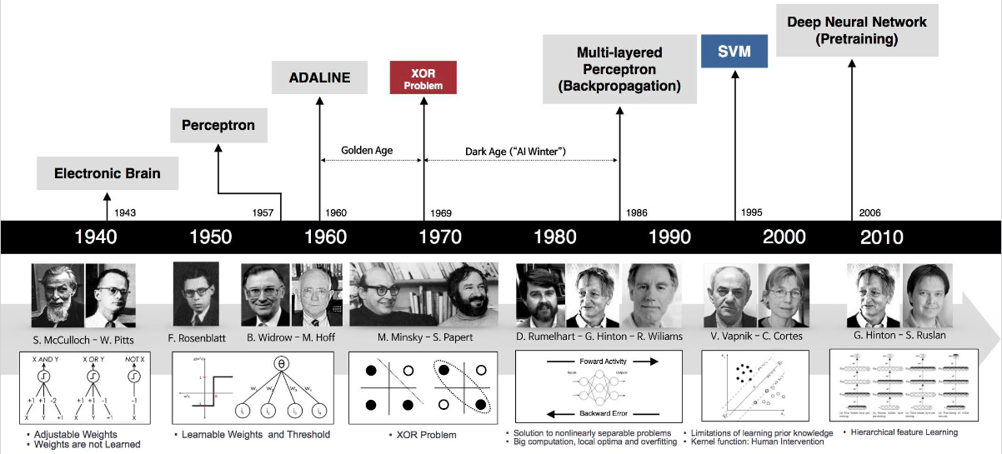
History of deep learning

Slide 3
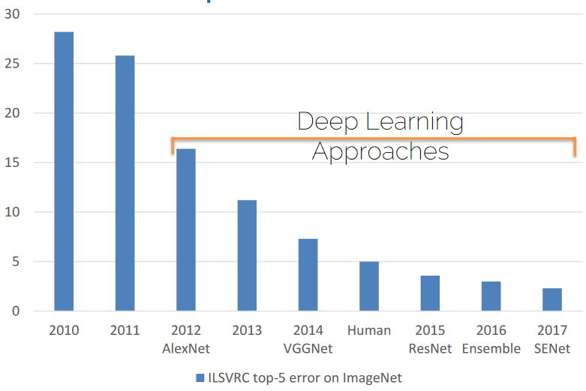
The Deep Learning Revolution

Slide 4
What has changed?
Big Data
Hardware
Deep
Hype
Software
Models can generalize
Models are trainable
Models are complex
Attacts more people
Models are easy to code

Slide 5
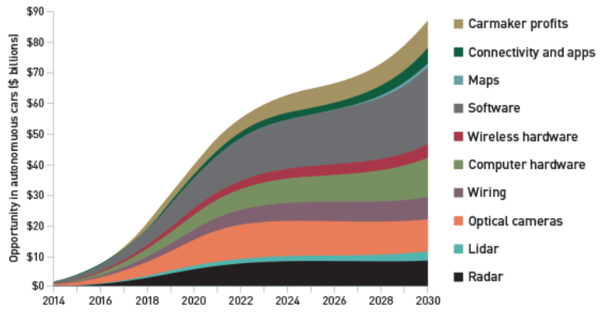
Why you should jump the weagon
“… the deep learning market is expected to be worth USD 1,722.9 Million by 2022”

Slide 6




The DL software landscape
No point in discussion who is best. The (biased) facts are:
Tensorflow are too a large extend used in production
Pytorch is used in research

Slide 7
How to make a modern deep learning framework
Tensors
Hardware acceleration
Automatic differentation
Abstraction to higher order data
Faster computations
Ease of use

Slide 8
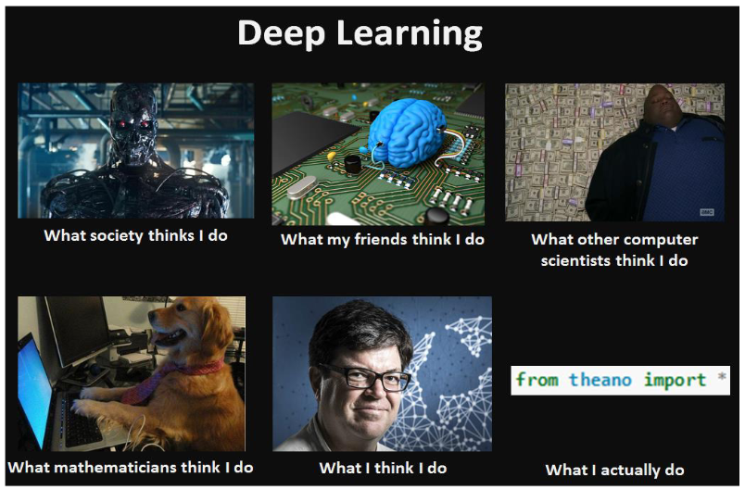
Meme of the day

